Slide 1

IMDB Movie Database
By: Akash Chhabra
Nick Castaldi
Ramon Manaios
Katheryn Raatz

Slide 2

Objectives
To analyze the trends in the movie theater industry
To explore the industry’s viability and direction
To make suggestions on how to improve the profitability of the movie theater industry

Slide 3

About Dataset
The data (IMDB movies extensive dataset) was obtained from Kaggle
The movies dataset includes 81,000+ movies with several attributes on each movie

Slide 4

Cleanup Process
Two data files were merged
Focused on:
U.S. only produced films
Films produced between 1997 and 2017

Slide 5

Questions
How is the movie industry doing in terms of its profitability?
Is there a correlation between movie budget and gross movie income?
What genres are the most and least profitable?
What are the most popular genres produced by the movie industry?
What are the most popular movie genres among viewers?
Is there a difference in movie preference among men and women?
Are gender and age groups determining factors in individuals’ movie attendance?

Slide 6
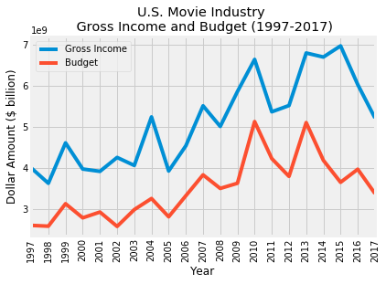
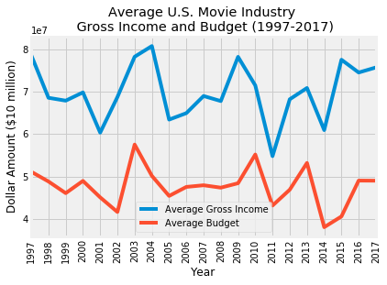
U.S. Movie Industry Gross Income and Budget
Notes:
What does the average show?

Slide 7
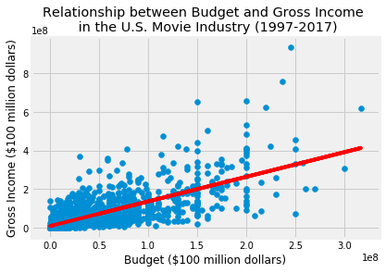
Correlation between Budget and Gross Income
Correlation coefficient (r-value) of 0.767089
Indicates a fairly strong, positive correlation
As the budget of a movie increases, so should the gross income

Slide 8
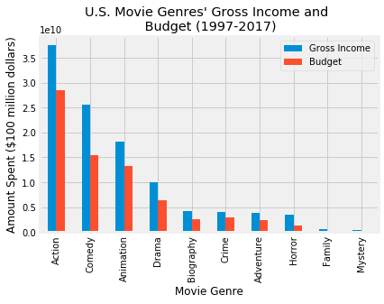
Most Profitable Movie Genres
Genres with the greatest budget, also produced the greatest gross income
Movies of the genre Action and Comedy gave the highest ROI
Notes:
Genres with the greatest budget also produced the greatest gross income, confirming the existence of a positive correlation

Slide 9
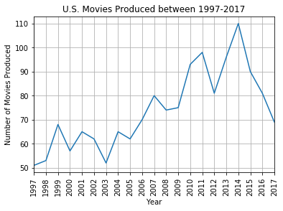
Number of Movies Produced in the U.S.
Movie production in the U.S. was at a steady increase until 2014, where production declined rapidly
Notes:
It is possible this is because they are partnering with other countries

Slide 10
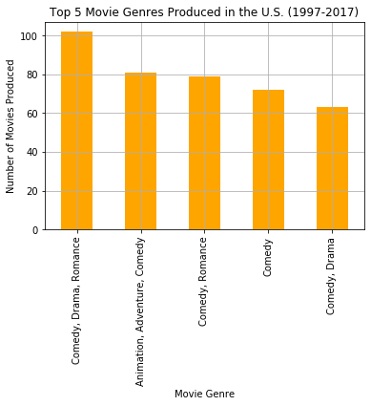
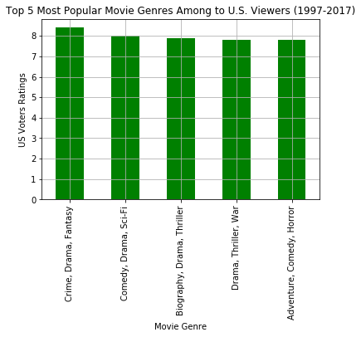
Top Genres Produced vs. Highest Rated Genres
Notes:
All the top movies produced include some aspect of Comedy in them
While the highest genres rated, 4 out of 5 of the top genres include drama

Slide 11
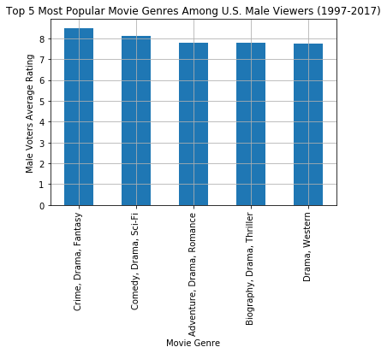
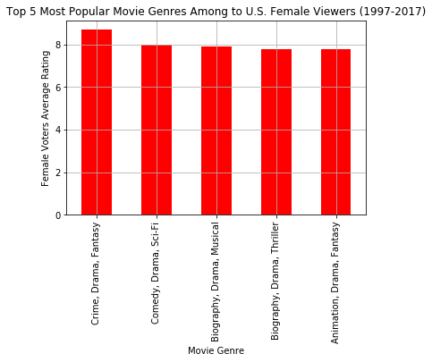
Top Movie Genres Among U.S. Men and Women
Notes:
In the top 5 genres rated among men and women, the top 2 are the same for both genders as well as the 4th highest rated genre of Bibliography, Drama, Thriller
But in both top 5 for each gender, all of the genres have a drama aspect to them

Slide 12
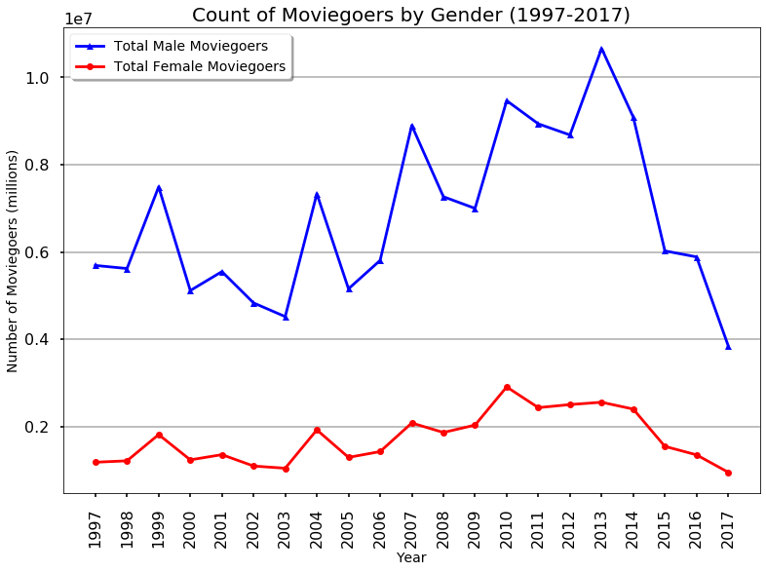
Number of Moviegoers by Gender
Males give more reviews to movies
May indicate more of an interest and attendance to movies
Notes:
We are correlating reviews to movie attendance

Slide 13
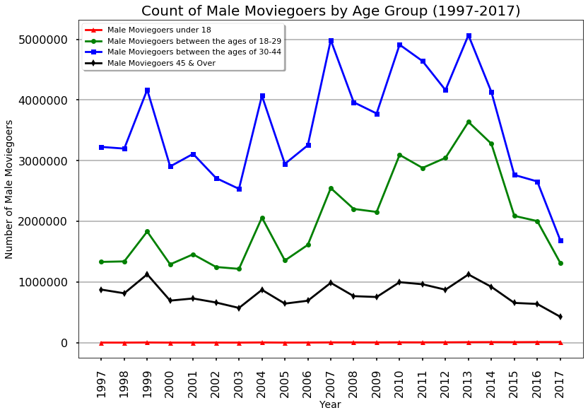
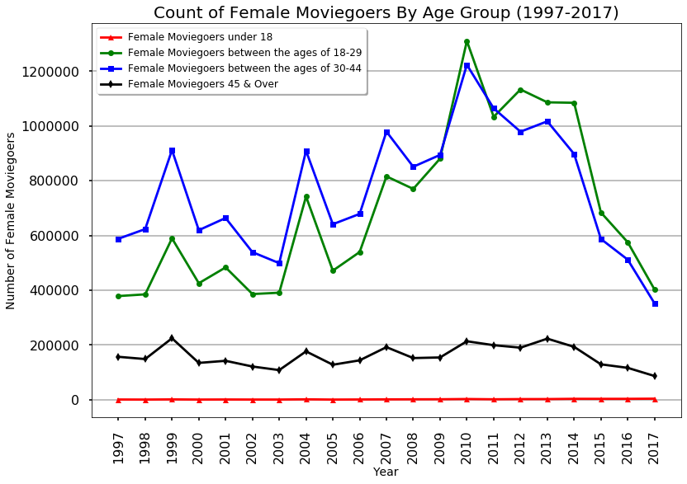
Female & Male Moviegoers by Age Group

Slide 14

Conclusions
The movie industry peaked in 2014 and has been declining since
Movies with higher budgets are shown to have higher revenues
Movies of the genres Action and Comedy performed the best in terms of profit
Drama genre or subgenre received the highest ratings from viewers
Male moviegoers between 30-44 years old showed the most interest in movies
Notes:
The tastes of men and women are not as distinct as one may think

